Slide 1
Unit II - REGRESSION ANALYSIS AND FORECASTING

Slide 2
Unit outcome
2. Illustrate the regression analysis and forecasting in time series analysis

Slide 3
What is regression?
Regression Analysis is a supervised learning analysis where supervised learning is the analyzing or predicting the data based on the previously available data or past data.
Regression analysis is a statistical technique for modeling and investigating the relationships between an outcome or response variable and one or more predictor or regressor variables.

Slide 4
Purpose of regression analysis:
The end result of a regression analysis study is often to generate a model that can be used to forecast or predict future values of the response variable, given specified values of the predictor variables.

Slide 5
Types of regression analysis
Simple Linear Regression:
In this simple linear regression there is only one dependent and one independent variable.
This linear regression model only one predictor. This linear regression model gives the linear relationship between the dependent and independent variables.
This simple linear regression analysis is mostly used in weather forecasting, financial analysis , market analysis .
It can be used for the predicting outcomes , increasing the efficiency of the models , make necessary measures to prevent the mistakes of the model.
Notes:
https://www.geeksforgeeks.org/what-is-regression-analysis/

Slide 6

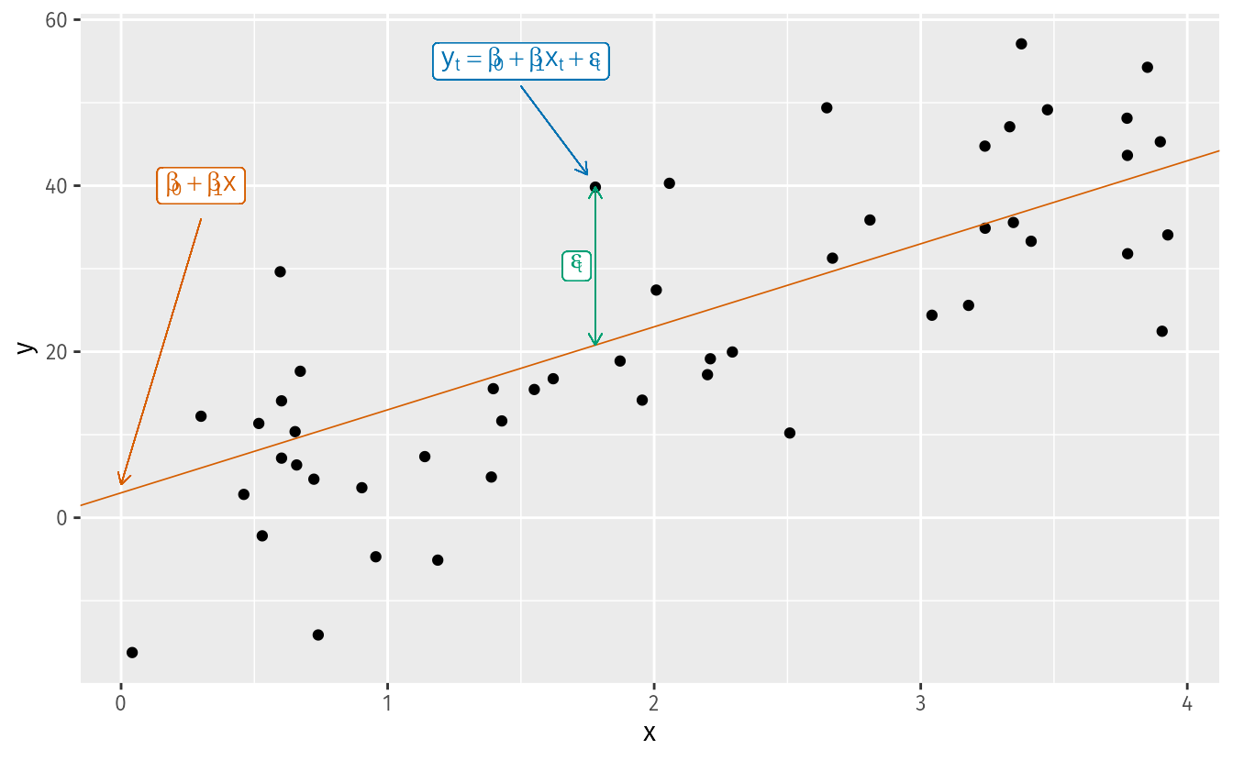
the regression model allows for a linear relationship between the forecast variable y and a single predictor variable x
The coefficients β0 and β1 denote the intercept and the slope of the line respectively.
The intercept β0 represents the predicted value of y when x=0.
The slope β1 represents the average predicted change in y resulting from a one unit increase in x.

Slide 7
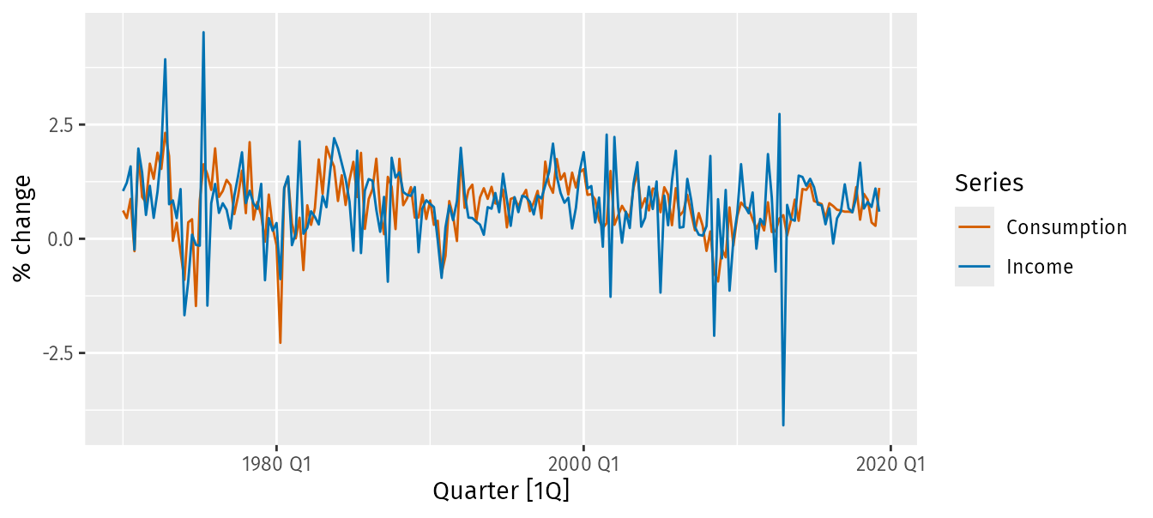
Example: US consumption expenditure
Figure shows time series of quarterly percentage changes (growth rates) of real personal consumption expenditure, y, and real personal disposable income, x, for the US from 1970 Q1 to 2019 Q2.
us_change |>
pivot_longer(c(Consumption, Income), names_to="Series") |>
autoplot(value) +
labs(y = "% change")

Slide 8

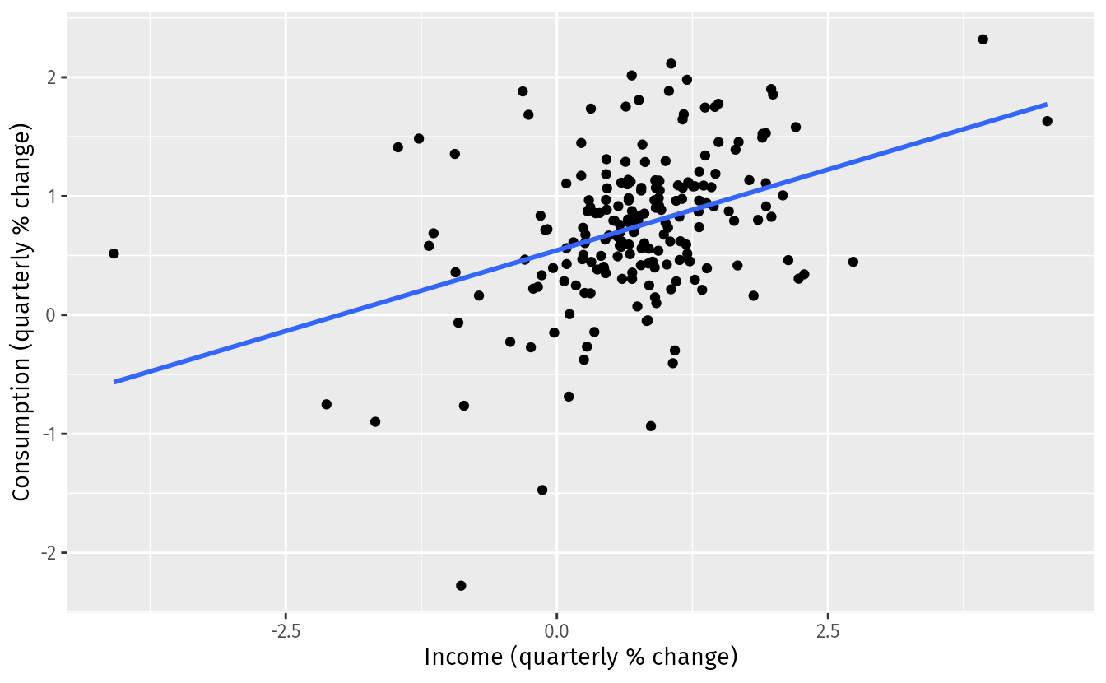
A scatter plot of consumption changes against income changes is shown in Figure along with the estimated regression line
us_change |>
ggplot(aes(x = Income, y = Consumption)) +
labs(y = "Consumption (quarterly % change)",
x = "Income (quarterly % change)") +
geom_point() +
geom_smooth(method = "lm", se = FALSE)

Slide 9
The mathematical equation for the simple linear regression model is shown below.
y=ax+b
where y is a dependent variable
x is a independent variable
a, b are the regression coefficients

Slide 10
Let us now calculate the value of a and b by solving the normal equations of the linear regression curve.
Normal equations of the linear regression equation y= b+ax is.
∑ y = n*b + a ∑ x
∑ x*y = b ∑ x + a ∑ x^2
where n is the total number of observations of the provided data/information for the above given information n=10
x | y | x^2 | xy
8 | 11 | 64 | 88
5 | 10 | 25 | 50
4 | 4 | 16 | 16
6 | 8 | 36 | 48
7 | 9 | 49 | 63
9 | 13 | 81 | 117
10 | 15 | 100 | 150
3 | 6 | 9 | 18
2 | 12 | 4 | 24
12 | 7 | 144 | 84

Slide 11
From the above table
n=10 , ∑ x = 66 , ∑ y = 95 , ∑ xy =1186 , ∑ x^2 = 528
Now the normal equations become :
95 = 10*b + 66a
1186 = 66*b + 528a
By solving the above two euations we get a = 6.05 and b = -30.429
The linear regression equation is y = -30.429 + 6.05 x.
Let us now discuss the implementation of the linear regression curve in R

Slide 12
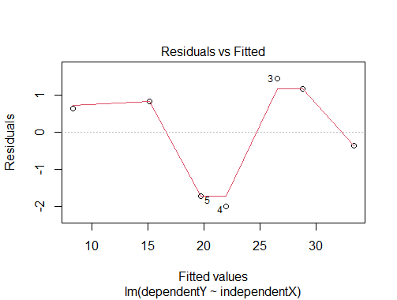
R Code
#Storing the independent value X
independentX<-c(5,7,8,10,11,13,16)
#soring the dependent value
dependentY<-c(33,30,28,20,18,16,9)
#performing the regression analysis using the function lm
linearregression<-lm(dependentY,independentX)
#printing the summary of the result
summary(linearregression)
#ploting the model
plot(linearregression)
plot(independentX,dependentY)

Slide 13

Multiple Linear Regression
Multiple linear regression analysis gives the relationship between the two or more independent varibales and a dependent variable.
Multiple linear regression can be represented as the hyper plane in multidimensional space . It is also a linear type regression analysis .
When there are two or more predictor variables, the model is called a multiple regression model. The general form of a multiple regression model is
where y is the variable to be forecast and x1,…,xk are the k predictor variables.
Each of the predictor variables must be numerical.
The coefficients β1,…,βk measure the effect of each predictor after taking into account the effects of all the other predictors in the model.
Thus, the coefficients measure the marginal effects of the predictor variables.

Slide 14
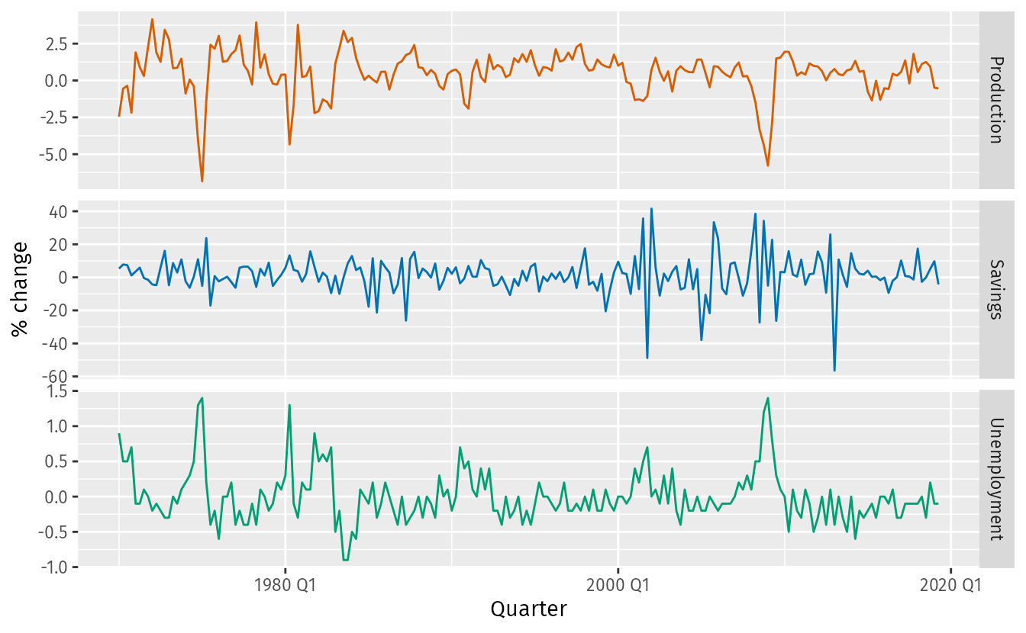
us_change |>
select(-Consumption, -Income) |>
pivot_longer(-Quarter) |>
ggplot(aes(Quarter, value, colour = name)) +
geom_line() +
facet_grid(name ~ ., scales = "free_y") +
guides(colour = "none") + labs(y="% change")

Slide 15
x1 | 1 | 2 | 3 | 4 | 5
x2 | 8 | 6 | 4 | 2 | 10
y | 3 | 7 | 5 | 9 | 11
x1 | x2 | y | x1^2 | x2^2 | x1*x2 | x1*y | x2*y
1 | 8 | 3 | 1 | 64 | 8 | 3 | 24
2 | 6 | 7 | 4 | 36 | 12 | 14 | 42
3 | 4 | 5 | 9 | 16 | 12 | 15 | 20
4 | 2 | 9 | 16 | 4 | 8 | 36 | 18
5 | 10 | 11 | 25 | 100 | 50 | 55 | 110
From the above table
n=5 , ∑ x1 = 15 , ∑ x2 = 30 , ∑ y = 35 , ∑ x1^2 = 55 , ∑ x2^2 = 220 , ∑ x1*x2 = 90 , ∑ x1*y = 123 , ∑ x2 *y = 214
Then the normal equations become: 35 = 5b + 15a0 + 30a1
123 = 15b + 55a0 + 90a1
214 = 30b + 90a0 + 220a1
By solving the above three normal equations we get the values of a0 , a1 and b .
a0 = 1.8 , a1 = 0.1 , b = 1.666
The multilinear regression analysis curve can be fit as y = 1.666 + 1.8*x1 + 0.1 * x2 .

Slide 16
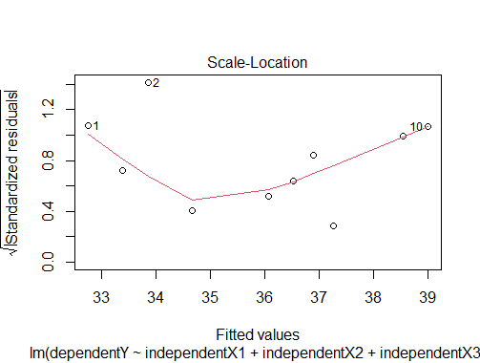
R Code
#in this we are performing the multi linear regression using the three independent
#storing the three independent variables
independentX1<-c(8,10,15,19,20,11,16,13,6,18)
independentX2<-c(22,26,24,32,38,39,29,13,15,25)
independentX3<-c(28,26,24,22,29,25,27,23,20,21)
#storing the dependent variable y
dependentY<-c(43,12,45,48,33,37,39,38,36,28)
#performing the multilinear regression analysis
multilinear<-lm(dependentY~independentX1+independentX2+independentX3)
#printing the summary of the result
summary(multilinear)
plot(multilinear)
Notes:
https://www.geeksforgeeks.org/what-is-regression-analysis/

Slide 17
Polynomial Regression
Polynomial regression analysis is a non linear regression analysis .
Polynomial regression analysis helps for the flexible curve fitting of the data , involves the fitting of polynomial equation of the data.
Polynomial regression analysis is the extension of the simple linear regression analysis by adding the extra independent variables obtained by raising the power .
y=a0+a1x+a2x^2+………..+anx^n
where y is dependent variable
x is independent variable
a0,a1,a2 are the coefficeients of independent variable.

Slide 18
Exponential Regression
Expenential regression is a non linear type of regression .
Exponential regression can be expressed in two ways .
Exponential regression can be used in finance , biology , physics etc fields . Let us look the mathematical expression for the exponential regression with example.
y=ae^(bx)
where y is dependent variable
x is independent variable
a , b are the regression coefficients.

Slide 19
What is the Least Squares Regression method and why use it?
Least squares is a method to apply linear regression.
It helps us predict results based on an existing set of data as well as clear anomalies in our data.
Anomalies are values that are too good, or bad, to be true or that represent rare cases.
we have a collection of observations but we do not know the values of the coefficients β0,β1,…,βk. These need to be estimated from the data.
The least squares principle provides a way of choosing the coefficients effectively by minimizing the sum of the squared errors.
That is, we choose the values of β0,β1,…,βk that minimize
Notes:
https://otexts.com/fpp3/least-squares.html

Slide 20

This is called least squares estimation because it gives the least value for the sum of squared errors.
Finding the best estimates of the coefficients is often called “fitting” the model to the data, or sometimes “learning” or “training” the model.

Slide 21
Example: US consumption expenditure
A multiple linear regression model for US consumption is
where y is the percentage change in real personal consumption expenditure,
x1 is the percentage change in real personal disposable income,
x2 is the percentage change in industrial production,
x3 is the percentage change in personal savings and
x4 is the change in the unemployment rate.

Slide 22
The TSLM() function fits a linear regression model to time series data.
It is similar to the lm() function which is widely used for linear models, but TSLM() provides additional facilities for handling time series.

Slide 23
fit_consMR <- us_change |>
model(tslm = TSLM(Consumption ~ Income + Production +
Unemployment + Savings))
report(fit_consMR)
#> Series: Consumption
#> Model: TSLM
#>
#> Residuals:
#> Min 1Q Median 3Q Max
#> -0.9055 -0.1582 -0.0361 0.1362 1.1547
#>
#> Coefficients:
#> Estimate Std. Error t value Pr(>|t|)
#> (Intercept) 0.25311 0.03447 7.34 5.7e-12 ***
#> Income 0.74058 0.04012 18.46 < 2e-16 ***
#> Production 0.04717 0.02314 2.04 0.043 *
#> Unemployment -0.17469 0.09551 -1.83 0.069 .
#> Savings -0.05289 0.00292 -18.09 < 2e-16 ***
#> ---
#> Signif. codes: 0 '***' 0.001 '**' 0.01 '*' 0.05 '.' 0.1 ' ' 1
#>
#> Residual standard error: 0.31 on 193 degrees of freedom
#> Multiple R-squared: 0.768, Adjusted R-squared: 0.763
#> F-statistic: 160 on 4 and 193 DF, p-value: <2e-16

Slide 24

Fitted values
Predictions of y can be obtained by using the estimated coefficients in the regression equation and setting the error term to zero. In general we write,
Plugging in the values of x1,t,…,xk,t for t=1,…,T returns predictions of yt within the training set, referred to as fitted values.

Slide 25
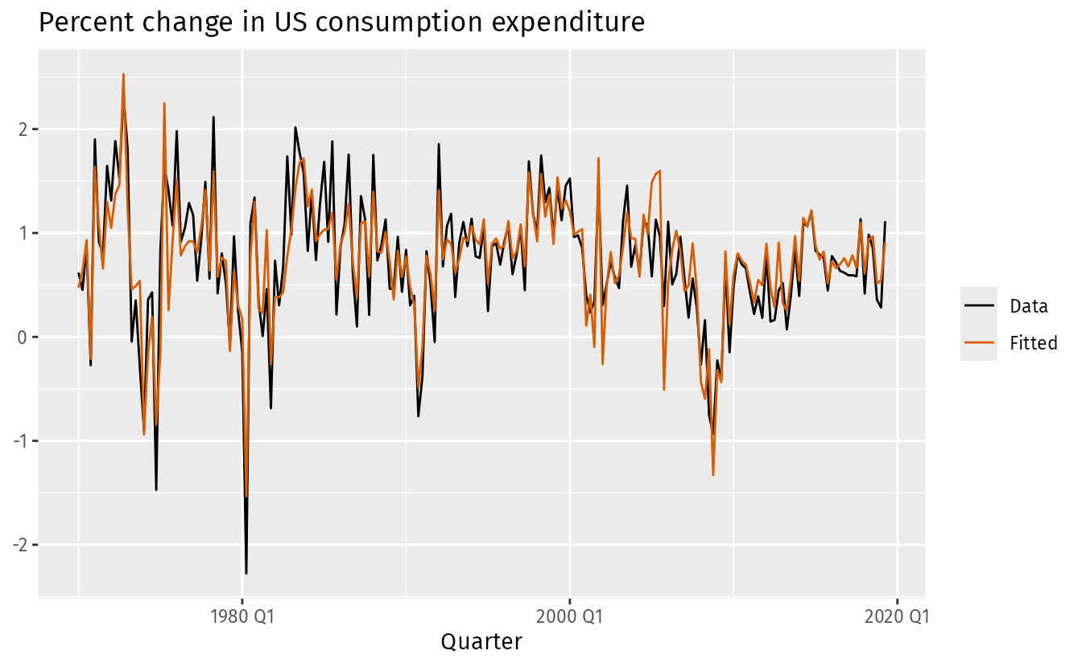
augment(fit_consMR) |>
ggplot(aes(x = Quarter)) +
geom_line(aes(y = Consumption, colour = "Data")) +
geom_line(aes(y = .fitted, colour = "Fitted")) +
labs(y = NULL,
title = "Percent change in US consumption expenditure"
) +
scale_colour_manual(values=c(Data="black",Fitted="#D55E00")) +
guides(colour = guide_legend(title = NULL))

Slide 26
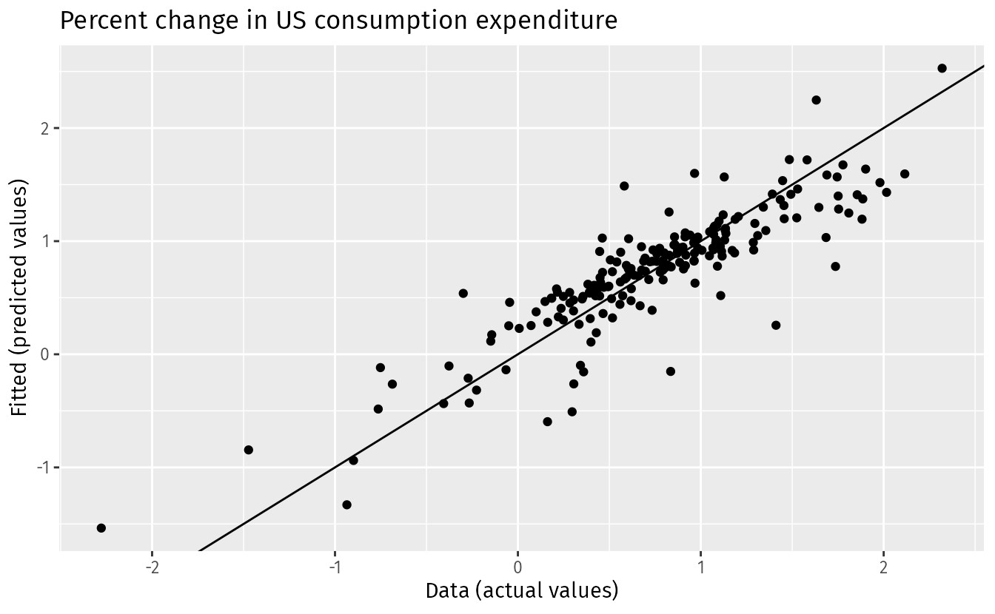
augment(fit_consMR) |>
ggplot(aes(x = Consumption, y = .fitted)) +
geom_point() +
labs(
y = "Fitted (predicted values)",
x = "Data (actual values)",
title = "Percent change in US consumption expenditure"
) +
geom_abline(intercept = 0, slope = 1)

Slide 27
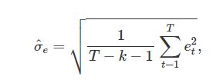
Standard error of the regression
Another measure of how well the model has fitted the data is the standard deviation of the residuals, which is often known as the “residual standard error”
The standard error will be used when generating prediction intervals,
where k is the number of predictors in the model.
Notice that we divide by T−k−1 because we have estimated k+1 parameters (the intercept and a coefficient for each predictor variable) in computing the residuals.
The standard error is related to the size of the average error that the model produces.

Slide 28
Unit II - REGRESSION ANALYSIS AND FORECASTING

Slide 29
Unit outcome
2. Illustrate the regression analysis and forecasting in time series analysis

Slide 30
Statistical Inference in Linear Regression
In this section, we describe several important hypothesis-testing procedures and a confidence interval estimation procedure.
These procedures require that the errors 𝜀i in the model are normally and independently distributed with mean zero and variance 𝜎2, abbreviated NID(0, 𝜎2).
What is the significance test for linear regression?
Significance tests for linear regression are used to determine if the relationship between the dependent variable and one or more independent variables is statistically significant.

Slide 31
Test for Significance of Regression
The test for significance of regression is a test to determine whether there is a linear relationship between the response variable y and a subset of the predictor or regressor variables x1, x2,…, xk.
The appropriate hypotheses are
H0 : 𝛽1 = 𝛽2 = ⋯ = 𝛽k = 0
H1 : at least one 𝛽j ≠ 0 Eq.
Rejection of the null hypothesis H0 in Eq. implies that at least one of the predictor variables x1, x2,…, xk contributes significantly to the model

Slide 32
Introduction to Hypothesis Testing
A statistician will make a decision about whether these claims are true or false. This process is called hypothesis testing.
A hypothesis test involves collecting data from a sample and evaluating the data.
Notes:
https://ecampusontario.pressbooks.pub/introstats/chapter/8-1-introduction-to-hypothesis-testing/

Slide 33
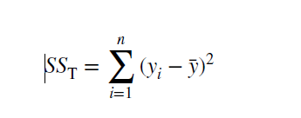
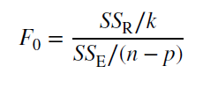
The test procedure involves an analysis of variance partitioning of the total sum of squares
into a sum of squares due to the model (or to regression) and a sum of squares due to residual (or error), say,
SST = SSR + SSE
Now if the null hypothesis in Eq.( H1 : at least one 𝛽j ≠ 0 ) is true and the model errors are normally and independently distributed with constant variance as assumed, then the test statistic for significance of regression is

Slide 34
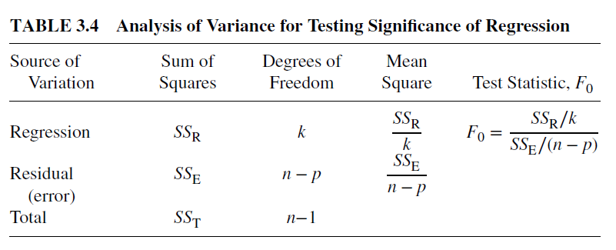
Calculate the Sum of Squares Total (SST): SST represents the total variation in the dependent variable. It's calculated as the sum of the squared differences between each data point and the mean of the dependent variable.
Calculate the Sum of Squares Regression (SSR): SSR represents the variation in the dependent variable that your model explains. It's calculated as the sum of the squared differences between the predicted values from your model and the mean of the dependent variable.
Calculate the Residual Sum of Squares (SSE): SSE represents the unexplained variation or error in your model. It's calculated as the sum of the squared differences between the actual data points and the predicted values from your model.
Compute R-squared (R²): R-squared is calculated as the ratio of SSR to SST. In other words, it tells you what proportion of the total variation in the dependent variable is explained by your model. The formula for R-squared is: R² = 1 - (SSE / SST)
Degrees of Freedom Where n is the sample size:
Notes:
https://www.kaggle.com/code/nargisbegum82/step-by-step-ml-linear-regression

Slide 35
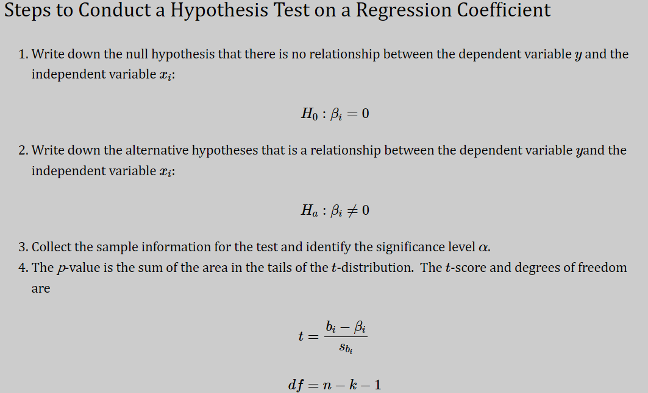
Tests on Individual Regression Coefficients We are frequently interested in testing hypotheses on the individual regression coefficients.
These tests would be useful in determining the value or contribution of each predictor variable in the regression model.

Slide 36
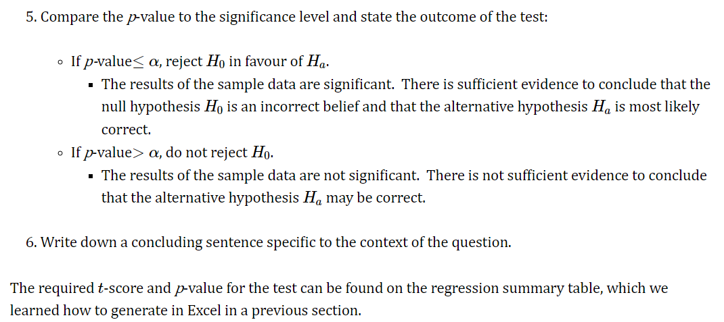

Slide 37
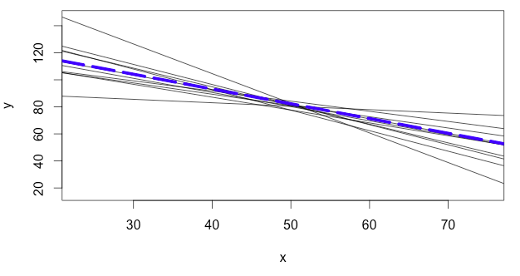
The image below shows these least square regression lines generated from different random samples as solid grey lines, and
the true population regression line as a dotted blue line.

Slide 38
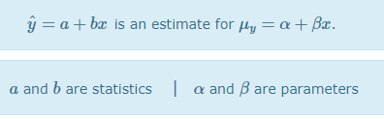
The least squares regression line (yˆ=a+bx), which runs through a sample of data points, is really an estimate of the true population regression line (μy=α+βx).

Slide 39
We conduct statistical inference in linear regression when we find a sample slope and
then use it to make a confidence interval or perform a hypothesis test about the true population slope.
Notes:
https://www.stats4stem.org/inference-linear-regression

Slide 40
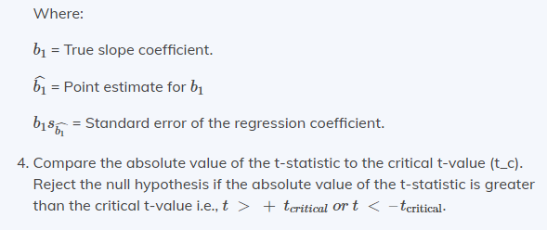

Hypothesis testing approach
The t-test Approach
The following are the steps followed in the performance of the t-test:
Set the significance level for the test.
Formulate the null and the alternative hypotheses.
Calculate the t-statistic using the formula below
Notes:
https://ecampusontario.pressbooks.pub/introstats/chapter/13-6-testing-the-regression-coefficients/
https://analystprep.com/cfa-level-1-exam/quantitative-methods/hypothesis-testing-in-regression-analysis/

Slide 41
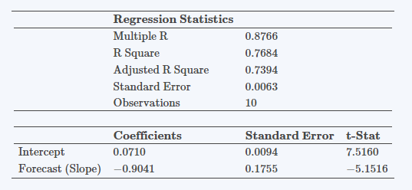
Example: Hypothesis Testing of the Significance of Regression Coefficients

Slide 42
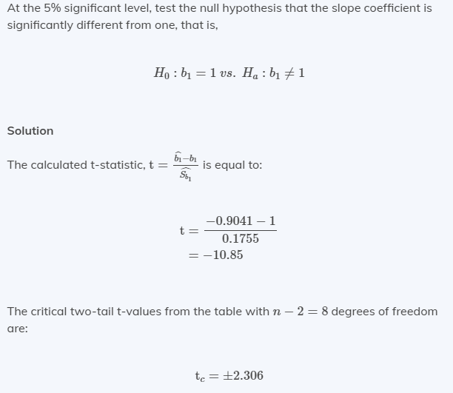
Notice that |t| > tc|t| > tc i.e., (10.85>2.30610.85>2.306)
Therefore, we reject the null hypothesis and conclude that the estimated slope coefficient is statistically different from one.

Slide 43
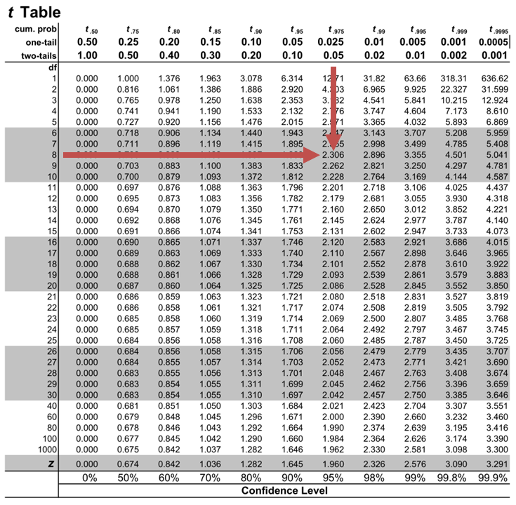

Slide 44
Tests on Groups of Coefficients
The procedure for doing this is the general regression significance test or, as it is more often called, the extra sum of squares method.
This procedure can also be used to investigate the contribution of a subset involving several regressor or predictor variables to the model.
y= X𝜷 + 𝜺, eq.
where y is (n × 1),
X is (n × p),
𝜷 is ( p × 1),
𝜺 is (n × 1), and p = k + 1.
We would like to determine if a subset of the predictor variables x1, x2, … , xr

Slide 45
Regression: Creating models to predict future observations
The Regression Approach for Predictions
Using regression to make predictions doesn’t necessarily involve predicting the future. Instead, you predict the mean of the dependent variable given specific values of the independent variable(s).

Slide 46
The general procedure for using regression to make good predictions is the following:
Research the subject-area so you can build on the work of others. This research helps with the subsequent steps.
Collect data for the relevant variables.
Specify and assess your regression model.
If you have a model that adequately fits the data, use it to make predictions.
Notes:
https://www.dataquest.io/blog/statistical-learning-for-predictive-modeling-r/

Slide 47
In R programming, predictive models are extremely useful for forecasting future outcomes and estimating metrics that are impractical to measure.
Notes:
https://www.dataquest.io/blog/statistical-learning-for-predictive-modeling-r/

Slide 48
Steps for prediction
Collect some data relevant to the problem (more is almost always better).
Clean, augment, and preprocess the data into a convenient form, if needed.
Conduct an exploratory analysis of the data to get a better sense of it.
Using what you find as a guide, construct a model of some aspect of the data.
Use the model to answer the question you started with, and validate your results.

Slide 49
Example
Linear regression is one of the simplest and most common supervised machine learning algorithms that data scientists use for predictive modeling
Example: regression to build a model that predicts cherry tree volume from metrics that are much easier for folks who study trees to measure.

Slide 50
Example continue
If you want to practice building the models and visualizations yourself, we’ll be using the following R packages:
data sets This package contains a wide variety of practice data sets. We’ll be using one of them, “trees”, to learn about building linear regression models.
ggplot2 We’ll use this popular data visualization package to build plots of our models.
GGally This package extends the functionality of ggplot2. We’ll be using it to create a plot matrix as part of our initial exploratory data visualization.
scatterplot3d We’ll use this package for visualizing more complex linear regression models with multiple predictors.

Slide 51
Example continue
How do they measure tree volume, anyway?
data(trees) ## access the data from R’s datasets package
head(trees) ## look at the first several rows of the data
str(trees) ## look at the structure of the variables
Girth | Height | Volume
8.3 | 70 | 10.3
8.6 | 65 | 10.3
8.8 | 63 | 10.2
10.5 | 72 | 16.4
10.7 | 81 | 18.8
10.8 | 83 | 19.7

Slide 52
Example continue
$ Girth : num | 8.3 8.6 8.8 10.5 10.7 10.8 11 11 11.1 11.2 …
$ Height: num | 70 65 63 72 81 83 66 75 80 75 …
$ Volume: num | 10.3 10.3 10.2 16.4 18.8 19.7 15.6 18.2 22.6 19.9 …
The trunk girth (in)
height (ft)
volume (ft³)
To decide whether we can make a predictive model, the first step is to see if there appears to be a relationship between our predictor and response variables (in this case girth, height, and volume).
ggpairs(data=trees, columns=1:3, title="trees data")
Let’s do some exploratory data visualization. We’ll use the ggpairs() function from the GGally package to create a plot matrix to see how the variables relate to one another.

Slide 53
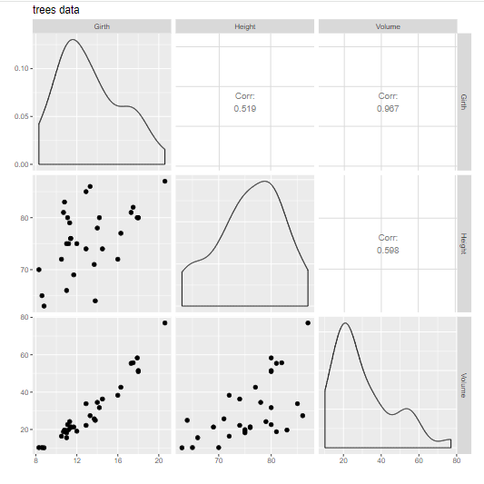
Example continue
The ggpairs() function gives us scatter plots for each variable combination, as well as density plots for each variable and the strength of correlations between variables.

Slide 54
Example continue
Forming a hypothesis and use
A hypothesis is an educated guess about what we think is going on with our data.
In this case, let’s hypothesize that cherry tree girth and volume are related.
Every hypothesis we form has an opposite: the “null hypothesis” (H0). Here, our null hypothesis is that girth and volume aren’t related.
In statistics, the null hypothesis is the one we use our data to support or reject; we can’t ever say that we “prove” a hypothesis.
We call the hypothesis that girth and volume are related our “alternative” hypothesis (Ha).
To summarize: H0 : There is no relationship between girth and volume
Ha: There is some relationship between girth and volume Our linear regression model is what we will use to test our hypothesis.
If we find strong enough evidence to reject H0, we can then use the model to predict cherry tree volume from girth.

Slide 55
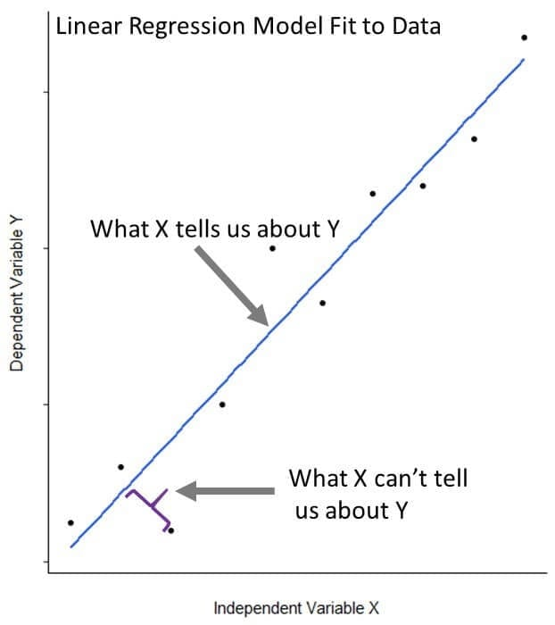
Example continue
Building blocks of a linear regression model
Let’s dive right in and build a linear model relating tree volume to girth. R makes this straight forward with the base function lm().
fit_1 <- lm(Volume ~ Girth, data = trees)
The lm() function fits a line to our data that is as close as possible to all 31 of our observations.

Slide 56
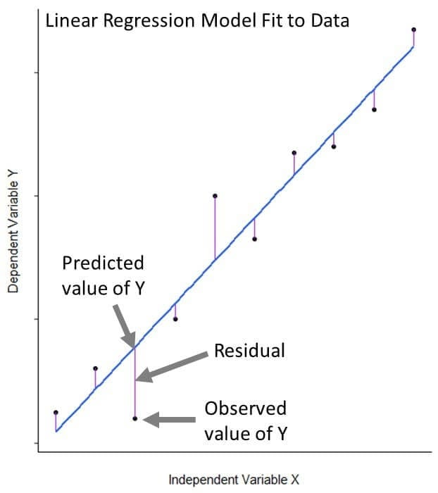
Example continue
Mathematically, can we write the equation for linear regression as: Y ≈ β0 + β1X + ε
The Y and X variables are the response and predictor variables from our data that we are relating to eachother
β0 is the model coefficient that represents the model intercept, or where it crosses the y axis
β1 is the model coefficient that represents the model slope, the number that gives information about the steepness of the line and its direction (positive or negative)
ε is the error term that encompasses variability we cannot capture in the model (what X cannot tell us about Y)

Slide 57
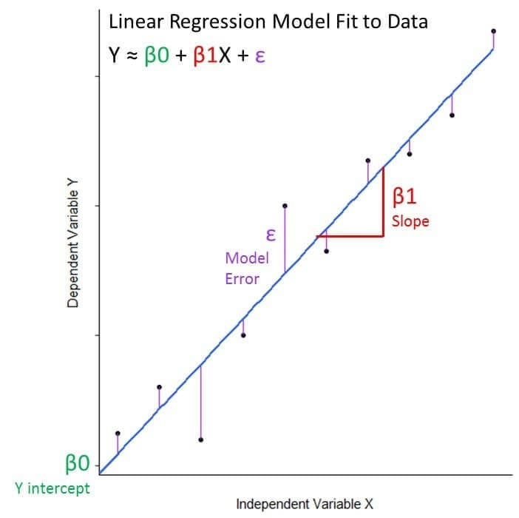
In the case of our example: Tree Volume ≈ Intercept + Slope(Tree Girth) + Error

Slide 58
Can we use this model to make predictions?
Whether we can use our model to make predictions will depend on:
Whether we can reject the null hypothesis that there is no relationship between our variables.
Whether the model is a good fit for our data.
Let’s call the output of our model using summary().
summary(fit_1)

Slide 59
Is the hypothesis supported?
Coefficients: Estimate and Std. Error:
The intercept in our example is the expected tree volume if the value of girth was zero. Of course we cannot have a tree with negative volume, but more on that later.
The slope in our example is the effect of tree girth on tree volume. We see that for each additional inch of girth, the tree volume increases by 5.0659 ft^{3.}
The coefficient standard errors tell us the average variation of the estimated coefficients from the actual average of our response variable.

Slide 60
t value:
This is a p-value, defined as the probability of observing any value equal or larger than t if H₀ is true. The larger the t statistic, the smaller the p-value. Generally, we use 0.05 as the cutoff for significance; when p-values are smaller than 0.05, we reject H₀.
We can reject the null hypothesis in favor of believing there to be a relationship between tree width and volume.

Slide 61
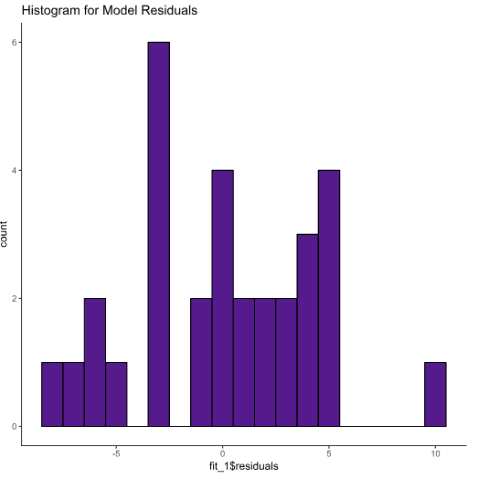
How well does the model fit the data?
Residuals:
We can make a histogram to visualize this using ggplot2.
ggplot(data=trees, aes(fit_1$residuals)) +
geom_histogram(binwidth = 1, color = "black", fill = "purple4") +
theme(panel.background = element_rect(fill = "white"),
axis.line.x=element_line(),
axis.line.y=element_line()) +
ggtitle("Histogram for Model Residuals")

Slide 62
Using our simple linear model to make predictions
predict(fit_1, data.frame(Girth = 18.2))
Adding more predictors: multiple linear regression
Girth | Height | Volume
18.2 in | 72 ft | 46.2 ft³
Notes:
https://www.dataquest.io/blog/statistical-learning-for-predictive-modeling-r/

Slide 63
Unit II - REGRESSION ANALYSIS AND FORECASTING

Slide 64
Unit outcome
2. Illustrate the regression analysis and forecasting in time series analysis

Slide 65
MODEL ADEQUACY CHECKING
What is Residuals?
A residual is a measure of how far away a point is vertically from the regression line. Simply, it is the error between a predicted value and the observed actual value.
Notes:
https://www.kaggle.com/code/saurav9786/time-series-tutorial
https://math.libretexts.org/Workbench/Numerical_Methods_with_Applications_(Kaw)/6%3A_Regression/6.05%3A_Adequacy_of_Linear_Regression_Models

Slide 66
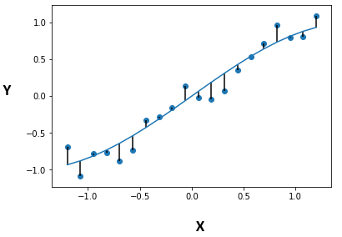
Figure 1 is an example of how to visualize residuals against the line of best fit. The vertical lines are the residuals.

Slide 67
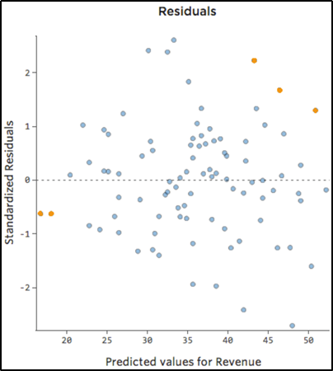
Residual Plots
A typical residual plot has the residual values on the Y-axis and the independent variable on the x-axis.
Figure 2 below is a good example of how a typical residual plot looks like.
Residual plots are the primary approach to model adequacy checking
Residual Plot Analysis
The most important assumption of a linear regression model is that the errors are independent and normally distributed.

Slide 68
Characteristics of Good Residual Plots
It has a high density of points close to the origin and a low density of points away from the origin
It is symmetric about the origin

Slide 69
Residuals Use
Residuals are useful in checking whether a model has adequately captured the information in the data.
A good forecasting method will yield residuals with the following properties:
The residuals are uncorrelated. If there are correlations between residuals, then there is information left in the residuals which should be used in computing forecasts.
The residuals have zero mean. If the residuals have a mean other than zero, then the forecasts are biased.

Slide 70
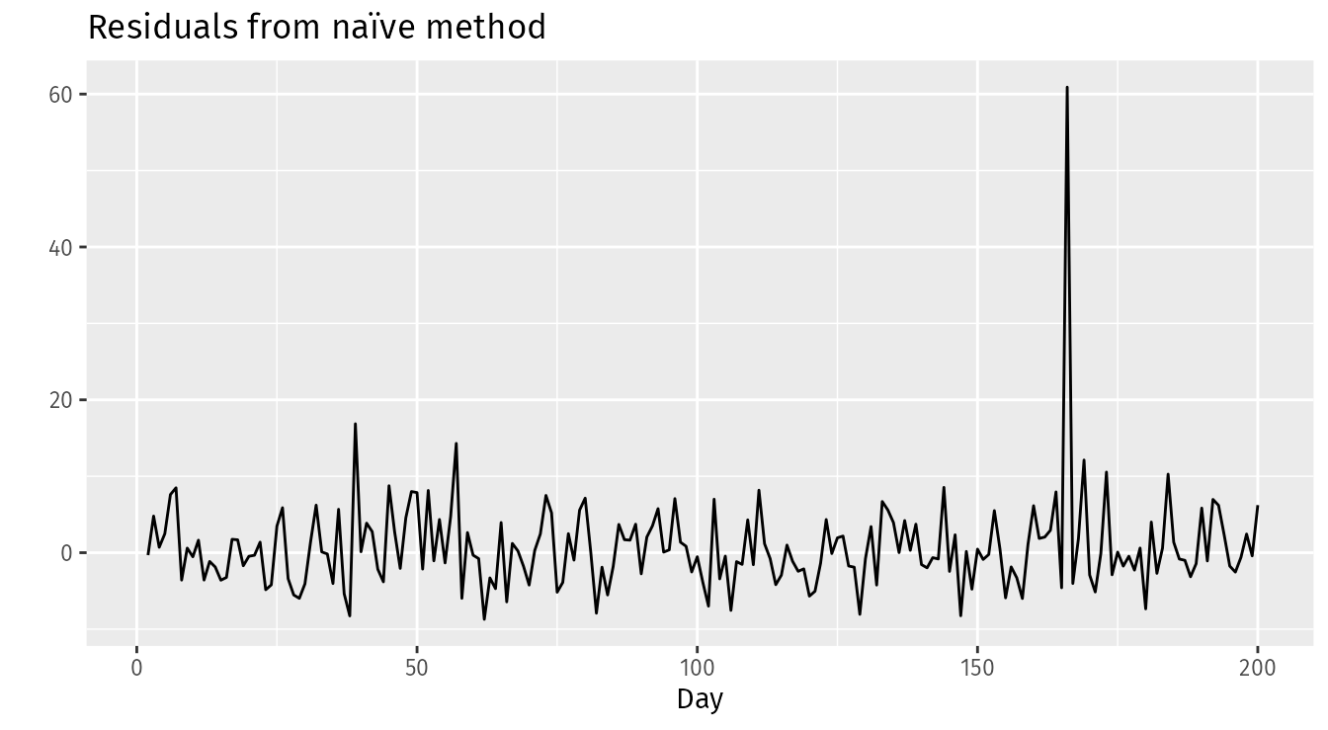
Example: Forecasting the Google daily closing stock price
For stock market prices and indexes, the best forecasting method is often the naïve method. That is, each forecast is simply equal to the last observed value.
The following graph shows the Google daily closing stock price (GOOG).
autoplot(goog200) +
xlab("Day") + ylab("Closing Price (US$)") +
ggtitle("Google Stock (daily ending 6 December 2013)")
res <- residuals(naive(goog200))
autoplot(res) + xlab("Day") + ylab("") +
ggtitle("Residuals from naïve method")

Slide 71
Scaled Residuals and PRESS
Residuals are the differences between observed and predicted values from a model.
Scaled residuals are adjusted versions of these residuals, often used to standardize them, making it easier to identify outliers or assess the overall fit of the model.
Scaled residuals are residuals from a statistical model that have been adjusted to account for variability, making them more comparable across different observations.
They are used to standardize residuals so that their distribution can be more easily analyzed, particularly when checking model assumptions like homoscedasticity (constant variance) and normality.

Slide 72
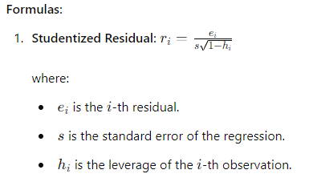

Slide 73

Scaled Residuals Methods
There are a few common methods to scale residuals:
1. Standardized Residuals: These are the residuals divided by an estimate of their standard deviation. For a linear regression model, this is often the standard error of the residuals. They help identify outliers and are useful in diagnostic plots.
where 𝑒𝑖​ is the residual for observation 𝑖,
𝜎^ is the estimated standard deviation of the residuals,
and ℎ𝑖𝑖 is the leverage of observation 𝑖𝑖.

Slide 74

2. Studentized Residuals: These are similar to standardized residuals but are more accurate for small sample sizes. They use a more precise estimate of the variance.
where 𝜎^(𝑖)is the estimated standard deviation of the residuals when the i-th observation is excluded.

Slide 75

Pearson Residuals: Commonly used in the context of generalized linear models (GLMs), these residuals are the difference between the observed and fitted values divided by the standard deviation of the observed values.
where 𝑦𝑖​ is the observed value, 𝑦^𝑖 ​ is the fitted value, and 𝜎^{^2}𝑖​ is the standard deviation of the observed value.

Slide 76

4. Deviance Residuals: Used in generalized linear models (GLMs), these are the signed square root of the contribution to the model's deviance for each observation. They are helpful for identifying poorly fitted data points.

Slide 77
PRESS (Predicted Residual Sum of Squares)
PRESS is a measure used to evaluate the predictive capability of a regression model.
It is particularly useful in assessing how well the model generalizes to new data.
The PRESS statistic is calculated by leaving out one observation from the dataset, fitting the model to the remaining data, predicting the left-out observation, and
then computing the squared difference between the observed and predicted values.
This process is repeated for each observation in the dataset, and the squared differences are summed.

Slide 78
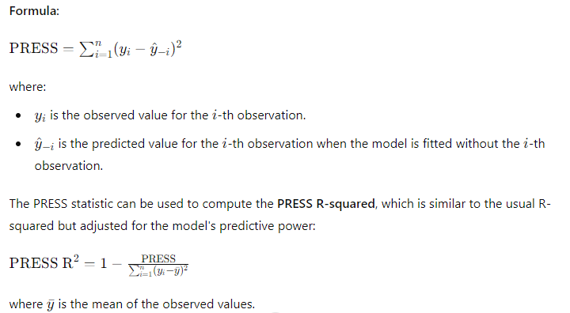

Slide 79
Usage and Interpretation
Scaled Residuals are useful for diagnosing potential issues with the model, such as outliers or influential points.
They help to identify observations that may disproportionately affect the model's fit.
PRESS and PRESS R-squared provide insights into the model's ability to predict new data.
A lower PRESS value indicates a model with better predictive accuracy, while a higher PRESS R-squared indicates a model that generalizes well.

Slide 80
Interpretation
Studentized residuals can help identify potential outliers. Typically, residuals greater than 2 or less than -2 may indicate outliers, depending on the context and sample size.
You can also use other packages like MASS for additional diagnostics, including calculating other types of residuals or using robust regression methods.

Slide 81
Example: Calculating Studentized Residuals in R
Explanation
Loading Necessary Packages: The car package is useful for various regression diagnostics, including calculating studentized residuals.
Creating Example Data: We create a simple dataset with x as the predictor and y as the response variable.
Fitting a Linear Model: The lm() function is used to fit a linear model, with y as the response and x as the predictor.
Calculating Studentized Residuals: The rstudent() function from the car package calculates the studentized residuals, which are printed to the console.
# Load necessary package
install.packages("car") # if not already installed
library(car)
# Example data
data <- data.frame(
x = c(1, 2, 3, 4, 5, 6, 7, 8, 9, 10),
y = c(2.3, 2.9, 3.2, 4.5, 5.1, 6.8, 7.3, 8.0, 9.5, 9.8)
)
# Fit a linear model
model <- lm(y ~ x, data = data)
# Summary of the model
summary(model)
# Calculate studentized residuals
studentized_residuals <- rstudent(model)
# Output studentized residuals
print(studentized_residuals)

Slide 82
Variable Selection Methods in Regression
Variable selection is a crucial aspect of building regression models, as it helps in identifying the most relevant predictors and improving model interpretability, accuracy, and generalizability.

Slide 83
1. Stepwise Selection
Stepwise selection methods iteratively add or remove variables based on specific criteria. There are three main types:
Forward Selection: Starts with no predictors and adds variables one by one, based on a chosen criterion (e.g., p-value, AIC, BIC). The process stops when no additional significant predictors can be added.
Backward Elimination: Starts with all candidate variables and removes the least significant variable at each step, again based on a criterion, until no insignificant predictors remain.
Stepwise Selection (Both Directions): Combines forward selection and backward elimination by adding or removing variables at each step based on the criterion.

Slide 84
How Forward Selection Works:
Start with No Predictors:
Begin with an empty model that contains no predictors (independent variables).
Add Variables One by One:
Evaluate each predictor variable individually to see how well it improves the model when added. This is typically done by fitting the model with one predictor at a time and assessing the performance using a chosen criterion.
Choose the Best Predictor:
Select the predictor that improves the model the most according to the chosen criterion. This criterion can be a statistical measure like the p-value, AIC (Akaike Information Criterion), BIC (Bayesian Information Criterion), or adjusted R-squared.
Repeat the Process:
Add the chosen predictor to the model and then repeat the process by evaluating the remaining predictors. The model is refitted with the new predictor included, and the evaluation criterion is used to determine the next best predictor to add.
Stop When Criteria Are Met:
Continue adding predictors until no additional variables meet the criterion for inclusion, or until a specified stopping rule is met (such as a predetermined number of predictors or the criterion no longer improving).

Slide 85
Criteria for Selecting Predictors:
p-Value: Often used in hypothesis testing to determine the statistical significance of a predictor. Predictors with lower p-values are considered more significant.
AIC (Akaike Information Criterion): A measure of the relative quality of a model. It balances model fit and complexity, with lower AIC values indicating better models.
BIC (Bayesian Information Criterion): Similar to AIC, but penalizes model complexity more heavily. Lower BIC values are preferred.
Adjusted R-squared: Indicates the proportion of variance explained by the predictors, adjusted for the number of predictors. Higher values suggest better model fit.

Slide 86
2. Lasso Regression (Least Absolute Shrinkage and Selection Operator)
Lasso regression is a regularization technique that includes a penalty proportional to the absolute value of the coefficients. It can shrink some coefficients to zero, effectively performing variable selection. The penalty term is controlled by a tuning parameter (λ), which can be selected using cross-validation.
Benefits of Lasso Regression
Simplicity and Interpretability: By shrinking some coefficients to zero, lasso regression helps in creating simpler models with fewer predictors, which are easier to interpret.
Prevents Overfitting: The regularization term reduces the risk of overfitting by discouraging overly complex models. This can lead to better generalization on new, unseen data.
Feature Selection: Lasso can automatically select a subset of features and discard others, which is particularly useful when dealing with high-dimensional data.

Slide 87
3. Ridge Regression
Ridge regression is another regularization technique that includes a penalty proportional to the square of the coefficients. Unlike lasso, it does not perform variable selection but can reduce multi-collinearity and improve model stability.
Benefits of Ridge Regression
Handles Multicollinearity: By adding a penalty term, ridge regression can stabilize the coefficient estimates and reduce their variance.
Improves Prediction Accuracy: The regularization term helps to prevent overfitting, especially in models with many predictors or when the predictors are highly correlated.
Coefficients Shrinkage: It tends to shrink the coefficients towards zero but does not set them exactly to zero. This means it can keep all features in the model, unlike Lasso regression which can perform variable selection by setting some coefficients to zero.

Slide 88
4. Elastic Net
Elastic Net combines the penalties of both lasso and ridge regression. It can handle situations where there are highly correlated variables and can select groups of correlated variables.
PCA is a dimensionality reduction technique that transforms the predictors into a set of uncorrelated components. The first few components, which capture most of the variance, can be used in the regression model. PCA is helpful when dealing with multicollinearity.
5. Principal Component Analysis (PCA)

Slide 89
Principal Component Analysis
How PCA Works
Standardization: If the variables have different units or scales, standardize the data (i.e., subtract the mean and divide by the standard deviation) so that each variable contributes equally to the analysis.
Covariance Matrix: Compute the covariance matrix of the standardized data. This matrix captures the relationships between different variables.
Eigenvalues and Eigenvectors: Calculate the eigenvalues and eigenvectors of the covariance matrix. The eigenvectors represent the directions of maximum variance (principal components), and the eigenvalues represent the magnitude of these variances.
Sort and Select: Sort the eigenvectors by their corresponding eigenvalues in descending order. Select the top kkk eigenvectors to form a new matrix that will be used to transform the original data into the principal component space.
Transform Data: Multiply the original standardized data by the selected eigenvectors (principal components) to get the reduced representation of the data.

Slide 90
6. Information Criterion-Based Methods
Akaike Information Criterion (AIC): AIC is a measure of model quality that balances goodness of fit and model complexity. Lower AIC values indicate better models. It can be used to compare models with different sets of variables.
Bayesian Information Criterion (BIC): Similar to AIC, BIC includes a penalty term that increases with the number of parameters, favoring simpler models. It tends to select fewer variables than AIC.

Slide 91
7. Recursive Feature Elimination (RFE)
RFE is an iterative process that fits a model and removes the least significant features one by one. The model is re-fitted at each step, and features are ranked based on their importance.
8. Cross-Validation
Cross-validation techniques, like k-fold cross-validation, are used in conjunction with other methods to assess model performance and select the best set of variables. Cross-validation helps prevent overfitting and provides a more robust measure of a model's predictive capability.
9. Domain Knowledge
Incorporating domain knowledge can be crucial for variable selection. Experts may know which variables are most relevant, leading to more parsimonious and interpretable models.

Slide 92
Generalized and Weighted Least Squares
Generalized Least Squares (GLS) and Weighted Least Squares (WLS) are both extensions of the ordinary least squares (OLS) method, which are used when the assumptions of OLS are violated, particularly concerning the homoscedasticity and independence of errors.
Generalized Least Squares (GLS)
Purpose: GLS is used when the error terms in a regression model are not homoscedastic (i.e., they do not have constant variance) or are correlated.
This violation can lead to inefficient and biased estimates in OLS.
GLS addresses these issues by transforming the model so that the transformed errors are homoscedastic and uncorrelated.

Slide 93
Generalized Least Squares (GLS)
Method:
GLS modifies the standard OLS approach by transforming the model to ensure that the error terms have constant variance and are uncorrelated.
Steps:
Estimate the covariance matrix Σ\SigmaΣ: This can be done through various methods, such as using residuals from an OLS fit.
Transform the model: Multiply both sides of the regression equation by Σ^{−1/2}
Apply OLS to the transformed model: This results in unbiased and efficient estimators for the regression coefficients.

Slide 94
Generalized Least Squares (GLS)
Application: GLS is used when there is a known form of heteroscedasticity or correlation structure among the errors, such as time series data with auto correlated errors or panel data with cross-sectional correlation.

Slide 95
Weighted Least Squares (WLS)
Purpose: WLS is a special case of GLS used when the error terms have non-constant variance (heteroscedasticity), but the errors are uncorrelated.
WLS assigns weights to each observation, with the weights being inversely proportional to the variance of the error term for that observation.
Method:
In WLS, weights are applied to each observation to account for the differing variances.
The weights are typically the inverse of the variances of the error terms.

Slide 96
Steps:
Determine the weights: These are often estimated as the inverse of the variances of the errors.
Transform the model: Multiply both sides of the regression equation by the square root of the weights
Apply OLS to the weighted model: This results in unbiased and efficient estimators for the regression coefficients.
wi

Slide 97
Key Differences
Assumptions about Errors:
GLS: Assumes heteroscedasticity and/or correlation in error terms.
WLS: Assumes heteroscedasticity but no correlation among errors.
Weights and Transformation:
GLS: Uses the covariance matrix Ω\OmegaΩ to transform the data.
WLS: Uses weights that are inversely proportional to the variance of the error terms.
Complexity:
GLS: More complex due to the need for estimating or knowing the covariance structure Ω\OmegaΩ.
WLS: Simpler, as it only requires knowledge or estimation of variances for weighting.
Both GLS and WLS improve the efficiency of estimates compared to OLS when the assumptions of OLS are not met. They help to achieve better estimates by appropriately accounting for the structure in the errors.

Slide 98
REGRESSION MODELS FOR GENERAL TIME SERIES DATA
Step 1: Data Preparation
1.1 Collect and Clean Data
Collect Data: Gather the time series data.
Clean Data: Handle missing values (impute or remove), remove outliers, and ensure data is in chronological order.
1.2 Exploratory Data Analysis (EDA)
Plot the Time Series: Visualize the data to identify trends, seasonality, and any anomalies.
Summary Statistics: Calculate mean, median, variance, etc.
Check for Stationarity: Use plots and statistical tests like the Augmented Dickey-Fuller (ADF) test.
1.3 Transform Data
Detrend: Remove long-term trends (e.g., differencing).
Deseasonalize: Remove seasonal effects.
Stabilize Variance: Apply transformations like log or Box-Cox if necessary.

Slide 99
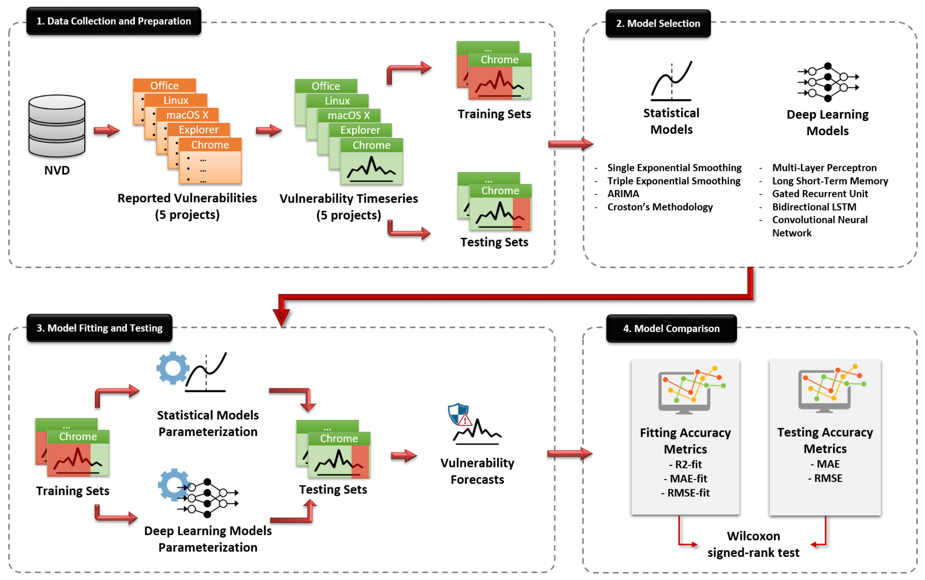

Slide 100
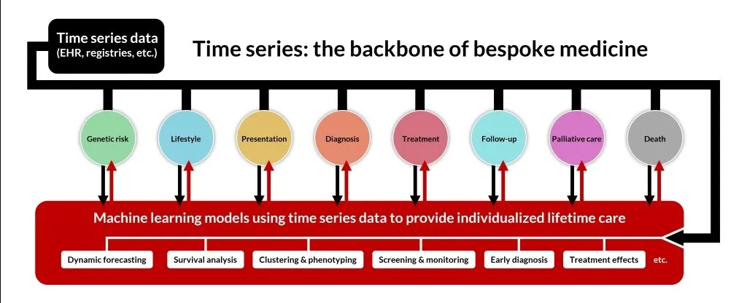

Slide 101
Step 2: Model Selection
2.1 Choose a Model
Depending on the characteristics of your time series data, select an appropriate model:
ARIMA: AutoRegressive Integrated Moving Average for univariate time series.
SARIMA: Seasonal ARIMA for time series with seasonality.
VAR: Vector AutoRegression for multivariate time series.
SARIMAX: Seasonal ARIMA with eXogenous regressors.
Holt-Winters: Exponential smoothing for trend and seasonality.
Machine Learning Models: Random Forest, XGBoost, etc., for capturing non-linear relationships.
2.2 Split Data
Training and Testing Sets: Split the data into training and testing sets to validate the model.

Slide 102
Step 3: Model Training
3.1 Define the Model
Use appropriate libraries and methods to define the model. For example, using statsmodels for ARIMA:
import statsmodels.api as sm
# ARIMA model example
model = sm.tsa.ARIMA(train_data, order=(p,d,q))
# SARIMAX model example
model = sm.tsa.SARIMAX(train_data, order=(p,d,q), seasonal_order=(P,D,Q,s), exog=exog_train)

Slide 103
3.2 Fit the Model
Fit the model to the training data:
3.3 Diagnose the Model
Check residuals to ensure they are white noise:
Plot Residuals: Residual plots should show no obvious patterns.
Ljung-Box Test: Test for autocorrelation in residuals.
ACF and PACF: Autocorrelation Function and Partial Autocorrelation Function plots of residuals.
model_fit = model.fit(disp=False)
print(model_fit.summary())

Slide 104
Step 4: Forecasting and Validation
4.1 Make Predictions
Predict on the training set and forecast future values:
# In-sample prediction
in_sample_pred = model_fit.predict(start, end)
# Out-of-sample forecast
forecast = model_fit.forecast(steps=len(test_data), exog=exog_test)

Slide 105
4.2 Evaluate Model Performance
Calculate performance metrics and visualize the results:
Metrics: Mean Absolute Error (MAE), Mean Squared Error (MSE), Root Mean Squared Error (RMSE), etc.
Plot Actual vs. Predicted: Compare actual values with predictions.
from sklearn.metrics import mean_squared_error
rmse = mean_squared_error(test_data, forecast, squared=False)
print(f'RMSE: {rmse}')
import matplotlib.pyplot as plt
plt.figure(figsize=(10,6))
plt.plot(train_data, label='Train')
plt.plot(test_data, label='Test')
plt.plot(test_data.index, forecast, label='Forecast')
plt.legend()
plt.show()

Slide 106
4.3 Model Refinement
Parameter Tuning: Adjust model parameters to improve performance.
Cross-Validation: Validate the model with different subsets of the data.

Slide 107
Step 5: Implementation
5.1 Final Model Training
Train the model on the entire dataset for final implementation.
5.2 Deployment
Deploy the Model: For real-time or batch prediction.
Monitor Performance: Continuously monitor model performance and retrain as necessary.

Slide 108
Step 6: Documentation and Reporting
6.1 Documentation
Document Process: Detail each step, including assumptions and decisions made.
Create Visualizations: Use plots to illustrate findings and model performance.
6.2 Reporting
Summary Report: Present findings, model performance, and any recommendations.
Stakeholder Communication: Clearly communicate results to stakeholders.

Slide 109
Example Code
Here's an example code snippet using ARIMA:
# In-sample prediction
in_sample_pred = model_fit.predict(start=len(train_data), end=len(train_data)+len(test_data)-1, dynamic=False)
# Forecast
forecast = model_fit.forecast(steps=len(test_data))[0]
# Evaluate
rmse = mean_squared_error(test_data, forecast, squared=False)
print(f'RMSE: {rmse}')
# Plot
import matplotlib.pyplot as plt
plt.figure(figsize=(10,6))
plt.plot(train_data, label='Train')
plt.plot(test_data, label='Test')
plt.plot(test_data.index, forecast, label='Forecast')
plt.legend()
plt.show()
import pandas as pd
import statsmodels.api as sm
from sklearn.metrics import mean_squared_error
# Load data
data = pd.read_csv('time_series_data.csv', index_col='date', parse_dates=True)
# Split data
train_data = data[:'2022']
test_data = data['2023':]
# Fit ARIMA model
model = sm.tsa.ARIMA(train_data, order=(1,1,1))
model_fit = model.fit(disp=False)

Slide 110

Detecting Autocorrelation: The Durbin–Watson Test
The Durbin-Watson (DW) test is a statistical test used to detect the presence of autocorrelation at lag 1 in the residuals from a regression analysis.
Autocorrelation occurs when the residuals (errors) of a model are not independent of each other, which can lead to inefficient estimates and invalid statistical inferences.
The test developed by Durbin andWatson (1950, 1951, 1971) is a very widely used procedure. This test is based on the assumption that the errors in the regression model are generated by a first-order autoregressive process observed at equally spaced time periods; that is,

Slide 111
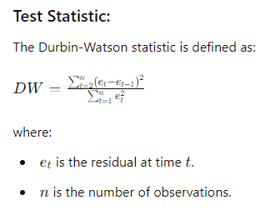
Durbin-Watson Test Overview
Purpose:
The DW test assesses whether the residuals from a linear regression model are serially correlated. This is crucial because the presence of autocorrelation violates the assumption of independent errors, which is fundamental to the validity of many regression techniques.
Test Statistic:
The Durbin-Watson statistic is defined as:

Slide 112
Interpretation:
DW ≈ 2: No autocorrelation.
DW < 2: Positive autocorrelation.
DW > 2: Negative autocorrelation.
The DW statistic ranges from 0 to 4:
A value close to 0 indicates strong positive autocorrelation.
A value close to 4 indicates strong negative autocorrelation.
A value around 2 suggests no autocorrelation.
Hypotheses:
Null Hypothesis (H0): There is no autocorrelation (rho = 0 or ρ=0).
Alternative Hypothesis (H1): There is autocorrelation (rho ≠0 or ρ≠0).

Slide 113
Conducting the Durbin-Watson Test
Step-by-Step Procedure:
Fit the Regression Model: Fit your linear regression model to obtain residuals.
Calculate Residuals: Obtain the residuals from the regression model.
Compute the Durbin-Watson Statistic: Use the formula provided above or utilize statistical software to calculate the DW statistic.
Interpret the Results: Compare the DW statistic to the critical values or use the rule of thumb (around 2 indicates no autocorrelation).

Slide 114
Example Using Python
Here is an example using Python with the stats models library to perform the Durbin-Watson test:
import numpy as np
import pandas as pd
import statsmodels.api as sm
from statsmodels.stats.stattools import durbin_watson
# Example data
np.random.seed(0)
X = np.random.randn(100, 2)
X = sm.add_constant(X) # Adds a constant term to the predictor
y = X @ np.array([1, 0.5, -0.2]) + np.random.randn(100) # Linear relation with noise
# Fit the linear regression model
model = sm.OLS(y, X).fit()
# Get the residuals
residuals = model.resid
# Perform the Durbin-Watson test
dw_statistic = durbin_watson(residuals)
print(f'Durbin-Watson statistic: {dw_statistic}')

Slide 115
Estimating the Parameters in Time Series Regression Models
Definition:
Estimating parameters in time series regression models involves determining the coefficients that quantify the relationship between the dependent variable and one or more independent variables, while also accounting for temporal dependencies.
This process typically involves fitting a model to historical data and using statistical methods to derive the best estimates of the model parameters.

Slide 116
Purpose:
The primary purpose of estimating parameters in time series regression models is to:
Understand Relationships: Quantify how predictor variables influence the response variable over time.
Forecasting: Predict future values of the time series based on the historical data.
Control and Optimization: Make informed decisions in fields like finance, economics, environmental studies, and engineering.

Slide 117
Steps in Estimating Parameters:
1. Model Selection
Choose an appropriate model based on the data characteristics:
ARIMA (AutoRegressive Integrated Moving Average): Suitable for univariate time series.
SARIMA (Seasonal ARIMA): Extends ARIMA to handle seasonality.
VAR (Vector AutoRegression): For multivariate time series.
SARIMAX (Seasonal ARIMA with eXogenous factors): ARIMA with additional explanatory variables.
Holt-Winters: For capturing trends and seasonality in a time series.

Slide 118
2. Model Specification
Define the structure of the model, including the order of autoregression (p), differencing (d), and moving average (q) components for ARIMA models.
3. Parameter Estimation
Use historical data to estimate the parameters. This typically involves:
Maximum Likelihood Estimation (MLE): Commonly used for ARIMA models.
Least Squares: Often used for models like regression and VAR.
Gradient Descent: Used in more complex models and machine learning approaches.

Slide 119
4. Model Fitting
Fit the model to the data to find the parameter values that best explain the observed time series. This involves optimizing the chosen estimation criterion (e.g., minimizing the sum of squared errors).
5. Model Validation
Validate the model using diagnostic checks:
Residual Analysis: Check if residuals are white noise.
Goodness-of-Fit: Use metrics like AIC, BIC, and R-squared.
Cross-Validation: Split the data into training and testing sets to evaluate model performance.

Slide 120
The Cochrane–Orcutt Method
Definition:
The Cochrane–Orcutt method is an iterative procedure used to correct for serial correlation (autocorrelation) in the residuals of a linear regression model.
This method is specifically designed to handle the first-order autoregressive process, denoted as AR(1), where the residuals from the regression model are correlated with their own previous values.

Slide 121
Purpose:
The main purpose of the Cochrane–Orcutt method is to improve the efficiency of the parameter estimates in a linear regression model when the residuals exhibit autocorrelation.
Autocorrelation in residuals violates the classical assumption of ordinary least squares (OLS) regression, which assumes that the residuals are independent and identically distributed.
When autocorrelation is present, the OLS estimates are still unbiased but not efficient, meaning they do not have the smallest possible variance.

Slide 122
How to Use the Cochrane–Orcutt Method:
Initial Regression:
Estimate the Autoregressive Parameter (ρ/rho):
Transform the Variables:
Iterate:
Final Model:

Slide 123
Key Points:
Initial OLS Regression: Perform OLS regression and obtain residuals.
Estimate ρ/rho: Regress residuals on their lagged values to estimate ρ/rho.
Transform Variables: Adjust original variables based on ρ/rho.
Iterate: Refit the model and update ρ/rho until convergence.
Final Model: Use the transformed model for interpretation and prediction.
The Cochrane–Orcutt method is particularly useful when dealing with time series data where residuals are likely to be autocorrelated, thus improving the efficiency and reliability of the regression estimates.

Slide 124
Example
Below is an example of how to implement and plot the Cochrane-Orcutt method for a sales model using Python.
Step-by-Step Implementation
Simulate Sales Data: We'll generate some synthetic sales data with a linear trend and autocorrelated residuals.
Initial OLS Regression: Fit an ordinary least squares (OLS) regression model to the sales data.
Cochrane-Orcutt Transformation: Apply the Cochrane-Orcutt transformation to correct for autocorrelation.
Plot the Results: Plot the original sales data, the initial OLS fit, and the Cochrane-Orcutt corrected fit.

Slide 125
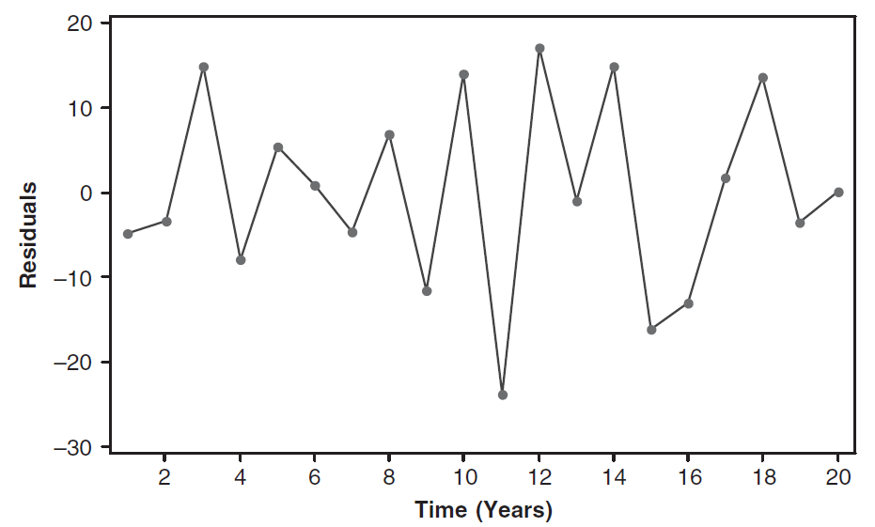

Slide 126
The Maximum Likelihood Approach in Regression Analysis
Definition:
The Maximum Likelihood (ML) approach is a method of estimating the parameters of a statistical model. In the context of regression analysis, it involves finding the parameter values that maximize the likelihood function, which measures how likely it is that the observed data were generated by the model with those parameters.

Slide 127
Purpose:
The Maximum Likelihood approach is used for several reasons:
Efficiency: ML estimators have desirable statistical properties, such as being asymptotically efficient, meaning they achieve the lowest possible variance among unbiased estimators as the sample size grows.
Flexibility: ML can be applied to a wide range of models, including those with non-normal error distributions and complex relationships.
Inference: ML allows for straightforward hypothesis testing and construction of confidence intervals.

Slide 128
Benefits of Maximum Likelihood:
Asymptotic Properties: ML estimators are consistent, asymptotically normal, and efficient.
Adaptability: It can be adapted to various types of data and models, including those with non-normal distributions.
Inference: Facilitates hypothesis testing and confidence interval construction through the likelihood ratio test, Wald test, and score test.

Slide 129
Example
import numpy as np
import pandas as pd
import statsmodels.api as sm
# Generate example data
np.random.seed(0)
n = 100
X = np.random.randn(n, 2)
X = sm.add_constant(X) # Adds a constant term to the predictor
beta = np.array([1, 0.5, -0.2])
y = X @ beta + np.random.randn(n)
# Fit the linear regression model using Maximum Likelihood
model = sm.OLS(y, X).fit(method='mle')
# Print the summary of the model
print(model.summary())
How to Implement: Here’s an example using Python and the statsmodels library to implement ML estimation for a linear regression model:
Explanation:
1. Generate Data:
Simulate a dataset with a linear relationship between the predictors and the response variable.
Specify the Model:
Use sm.add_constant(X) to add an intercept to the predictors.
Use the OLS class from statsmodels to specify the linear regression model.
Fit the Model Using ML:
The fit method with method='mle' fits the model using Maximum Likelihood Estimation.
Summary:
The summary method provides detailed results, including parameter estimates, standard errors, and goodness-of-fit measures.

Slide 130
Concept of Forecasting and Prediction Intervals
Forecasting:
Forecasting involves making predictions about future values of a time series based on observed historical data. In the context of regression and time series analysis, forecasting is used to estimate future outcomes by applying the fitted model to new data points.

Slide 131
Prediction Intervals:
A prediction interval provides a range within which future observations are expected to fall, with a specified level of confidence. Unlike confidence intervals, which estimate the range for the mean response, prediction intervals account for both the uncertainty in the parameter estimates and the variability of the future observations.

Slide 132
Importance of Prediction Intervals:
Uncertainty Quantification: Prediction intervals provide a measure of the uncertainty associated with predictions, helping to understand the range of possible future values.
Risk Management: In fields like finance, economics, and engineering, prediction intervals help in assessing potential risks and making informed decisions.
Reliability: They offer a more reliable understanding of the expected variability in future outcomes compared to point forecasts alone.

Slide 133
ECONOMETRIC MODELS
Key Concepts in Econometric Models
Econometric models are statistical models that use economic theory and data to estimate relationships between economic variables.
They play a crucial role in analyzing and interpreting economic phenomena, forecasting future trends, and guiding economic policy decisions.
Economic Theory:
Foundation: Econometric models are grounded in economic theory, which provides the hypotheses about relationships between variables. For example, economic theory might suggest that higher education leads to higher income.
Model Specification: Econometricians translate theoretical relationships into mathematical models that can be estimated using data.

Slide 134


Key Types of Econometric Models
1. Linear Regression Models:
Simple Linear Regression: Examines the relationship between two variables (one dependent and one independent) using a straight line.
Multiple Linear Regression: Extends the simple model to include multiple independent variables.
Usage: Estimating relationships between economic indicators, such as how education affects wages.

Slide 135
2. Time Series Models:
ARIMA (AutoRegressive Integrated Moving Average): Combines autoregressive, differencing, and moving average components to model time series data.
GARCH (Generalized Autoregressive Conditional Heteroskedasticity): Models volatility clustering in time series data.
Usage: Forecasting GDP, inflation rates, stock prices.

Slide 136

3. Panel Data Models:
Fixed Effects Model: Controls for time-invariant characteristics by allowing each entity to have its own intercept.
Random Effects Model: Assumes that individual-specific effects are random and uncorrelated with the independent variables.
Usage: Analyzing data across countries or firms over time.

Slide 137
4. Instrumental Variables (IV) Models:
Used when there is endogeneity (correlation between the regressors and the error term) to obtain unbiased estimates.
Two-Stage Least Squares (2SLS): A common method for estimating IV models.
Usage: Estimating the effect of education on earnings when education may be endogenous.

Slide 138
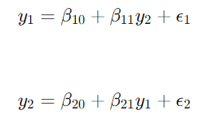
5. Simultaneous Equations Models:
Structural Equation Models: Contain multiple interdependent equations representing different economic relationships.
Usage: Modeling systems where variables simultaneously influence each other, such as supply and demand models.

Slide 139

6. Logit and Probit Models:
Logit Model: Used for binary dependent variables where the outcome is a probability
Probit Model: Similar to logit but uses the cumulative normal distribution function.
Usage: Modeling binary choices such as purchasing decisions or labor force participation.

Slide 140

7. Dynamic Models:
Vector Autoregression (VAR): Models the interdependencies among multiple time series.
Usage: Analyzing the joint behavior of multiple economic variables over time.

Slide 141
Applications of Econometric Models
Policy Analysis: Assessing the impact of fiscal and monetary policies on economic growth, inflation, and employment.
Economic Forecasting: Predicting future economic indicators such as GDP, inflation rates, and unemployment.
Market Analysis: Understanding and predicting consumer behavior, market demand, and pricing strategies.
Risk Management: Quantifying and managing financial risks using models of asset returns and volatility.

Slide 142

Example of Econometric Model Application
Scenario: Estimating the Impact of Education on Income
Objective: Determine how an additional year of education affects annual income.
Model Specification:
Data:
Dependent Variable: Income (annual income of individuals)
Independent Variable: Education (years of education)
Steps:
Collect Data: Gather data on income and education from a survey or dataset.
Fit Model: Use OLS regression to estimate β0\beta_0β0​ and β1\beta_1β1​.
Interpret Results: Analyze the estimated coefficient β1\beta_1β1​ to understand the impact of education on income.
Predict and Forecast: Use the model to predict income for different levels of education.

Slide 143
Estimation Techniques:
Ordinary Least Squares (OLS): Minimizes the sum of squared residuals to estimate parameters in linear regression models.
Maximum Likelihood Estimation (MLE): Estimates parameters by maximizing the likelihood function, often used in more complex models.
Two-Stage Least Squares (2SLS): Used in instrumental variables estimation to handle endogeneity.
Model Diagnostics:
Residual Analysis: Examines the residuals (errors) to check for patterns that might indicate problems with the model, such as autocorrelation or heteroskedasticity.
Goodness-of-Fit: Measures how well the model explains the variability in the dependent variable, often assessed using R-squared or adjusted R-squared.
Hypothesis Testing: Tests hypotheses about model parameters using t-tests, F-tests, and likelihood ratio tests.

Slide 144
Forecasting and Prediction:
Forecasting: Uses historical data and the fitted model to make predictions about future values.
Prediction Intervals: Provides a range within which future observations are expected to fall, considering both model uncertainty and inherent variability.
Application and Interpretation:
Policy Analysis: Assesses the impact of economic policies on various outcomes, such as how a tax change affects consumer spending.
Risk Management: Models financial risk and volatility to manage exposure and make informed decisions.
Market Analysis: Understands consumer behavior, market trends, and pricing strategies.

Slide 145
R Commands
1. Linear Regression To perform linear regression, you use the lm() function, which fits a linear model.
Example
# Load necessary library
library(tidyverse)
# Load example dataset
data(mtcars)
# Fit a linear model
model <- lm(mpg ~ wt + hp, data = mtcars)
# Summary of the model
summary(model)

Slide 146
2. Multiple Linear Regression
Similar to simple linear regression but with multiple predictors.
Example:
# Fit a multiple linear regression model
model_multi <- lm(mpg ~ wt + hp + qsec, data = mtcars)
# Summary of the model
summary(model_multi)

Slide 147
3. Logistic Regression For binary outcomes, use the glm() function with family = binomial.
Example:
# Simulate binary outcome variable
mtcars$am <- as.factor(mtcars$am)
# Fit a logistic regression model
logit_model <- glm(am ~ wt + hp, data = mtcars, family = binomial)
# Summary of the model
summary(logit_model)

Slide 148
4. Time Series Analysis For time series data, you can use the ts() function to create a time series object and auto.arima() from the forecast package for ARIMA modeling.
Example:
# Load the forecast package
library(forecast)
# Create a time series object
ts_data <- ts(mtcars$mpg, start = c(1970, 1), frequency = 12)
# Fit an ARIMA model
arima_model <- auto.arima(ts_data)
# Summary of the model
summary(arima_model)
# Forecasting
forecast_values <- forecast(arima_model, h = 10)
plot(forecast_values)

Slide 149
5. Panel Data Models For panel data, you might use the plm package. It allows for fixed effects or random effects models.
Example:
# Load the plm package
library(plm)
# Simulate panel data
data("Grunfeld", package = "plm")
# Fit a fixed effects model
fe_model <- plm(inv ~ value + capital, data = Grunfeld, model = "within")
# Summary of the model
summary(fe_model)
# Fit a random effects model
re_model <- plm(inv ~ value + capital, data = Grunfeld, model = "random")
# Summary of the model
summary(re_model)

Slide 150
6. Handling Multicollinearity: To check for multicollinearity, you can use the vif() function from the car package.
Example:
# Load the car package
library(car)
# Check for multicollinearity
vif(model_multi)

Slide 151
7. Checking Model Diagnostics: You can use diagnostic plots with the plot() function on the model object.
Example:
# Diagnostic plots for a linear model
par(mfrow = c(2, 2))
plot(model_multi)

Slide 152
8. Model Refinement
Refine models by adding or removing variables, and comparing models using metrics like AIC or BIC.
Example:
# Compare models using AIC
model1 <- lm(mpg ~ wt + hp, data = mtcars)
model2 <- lm(mpg ~ wt + hp + qsec, data = mtcars)
AIC(model1, model2)

Slide 153
9. Generalized Linear Models (GLM)
Definition: Generalized linear models extend linear models to allow for response variables that have error distribution models other than a normal distribution. It includes logistic, Poisson, and other models.
Example:
# Fit a generalized linear model (e.g., Poisson)
glm_model <- glm(counts ~ wt + hp, data = mtcars, family = poisson)
# Summary of the model
summary(glm_model)

Slide 154
10. Negative Binomial Regression
Definition: Negative binomial regression is used for count data with over dispersion (when variance exceeds the mean). It extends Poisson regression by adding a parameter to account for this over dispersion.
# Load the MASS package for negative binomial regression
library(MASS)
# Fit a negative binomial regression model
nb_model <- glm.nb(count ~ x1 + x2, data = dataset)
# Summary of the model
summary(nb_model)

Slide 155
Additional Resources
tidyverse: A collection of R packages for data manipulation and visualization.
forecast: For time series forecasting.
plm: For panel data analysis.
car: For regression diagnostics.
plm: For panel data models like fixed effects and random effects.
AER: For instrumental variables and other econometric methods.
survival: For survival analysis models like the Cox model.
quantreg: For quantile regression.
MASS: For negative binomial regression.

